Slide 1
Good practice in Research Data Management
Module 6: Tools, training and support

Slide 2
Topics
Newcastle University research tools
Additional training and further support

Slide 3
Newcastle University research tools

Slide 4
Introduction
Newcastle University seeks to supply researchers with tools and guidance
to help you do your research
to help you meet the requirements of funders
to assist with effective RDM

Slide 5
Tools by topic
Administration and planning for RDM
Sharing, collaborating and processing active data
Describing and cataloguing research data sets
Publicising and exchanging research data sets

Slide 6
Administration and planning for RDM
MyProjects
The system used to support and record University projects, particularly funded projects, throughout their lifecycle.
http://www.ncl.ac.uk/res/resources/myprojects/
DMPOnline
An online tool for assisting with writing of a RDM plan
Templates are provided to support UK research funders and institutional requirements
Plans can be shared with co-workers and exported in various document formats for further editing
https://dmponline.dcc.ac.uk/
Newcastle guidance:
http://research.ncl.ac.uk/rdm/tools/dmponline/

Slide 7
Sharing, collaborating and processing active data
File drop-off
Provides members of the University with the ability to temporarily share large data files securely
Useful for when the size of the data file is too large to be practicably sent by other means (e.g. as an email attachment)
Security level the same as sending the file as an email attachment
http://www.ncl.ac.uk/itservice/file-drop-off/

Slide 8
Sharing, collaborating and processing active data #2
Virtual Research Environment (VRE)
A set of online tools to facilitate or enhance the research process. The VRE can aid with collaboration and communication amongst members of a research group, wherever located.
http://www.ncl.ac.uk/itservice/vre/featuresofresearchtools/
Dropbox
An external tool for file storage and sharing
Data may be stored outside the EU and will not be recoverable by ISS
https://www.dropbox.com/

Slide 9
Sharing, collaborating and processing active data #3
e-Science Central
Allows researchers to do science within a web browser
Data analysis and workflow automation is facilitated, including through use of cloud computing storage and computational processing power
Options to allow controlled data sharing – including social networking features
http://www.esciencecentral.co.uk/
Google Drive (Docs)
An external tool for document storing, sharing & collaborative writing
Data may be stored outside the EU and will not be recoverable by ISS.
https://drive.google.com/

Slide 10
Describing and cataloguing research data sets
Research Data Catalogue (RDC)
A proof of concept tool
Designed with the intention of being the University’s bespoke system that provides a link between the MyProjects and MyImpact systems
Allows for recording of research data location and other important key descriptive information
https://crypt.ncl.ac.uk/controlpanels/iridium/datacatalogue/index.php

Slide 11
Publicising and exchanging research data sets
MyImpact
Allows researchers to manage and amend their research information
Such as: web profile, publications, PGR supervisions, projects (including research and consultancy)
The system that the University uses to manage its research portfolio and prepare for the forthcoming Research Excellence Framework (REF) 2014
http://www.ncl.ac.uk/res/resources/myimpact/

Slide 12
Publicising and exchanging research data sets #2
Blogs & wikis
Blogs are commonly used to share information, useful links, media, examples or experiences in relation to targeted subjects
http://www.ncl.ac.uk/itservice/blogs/
The wiki service provides a means by which a person or group of persons can add and edit content about a topic or topics in order to collaboratively create a collection of information
http://www.ncl.ac.uk/itservice/wikis/

Slide 13
Publicising and exchanging research data sets #3
Web Publishing
The web publishing service allows staff and students to create and publish institutionally-hosted websites
Can be used to promote and disseminate University business such as research
http://www.ncl.ac.uk/itservice/web/publishing/resconf/
SWORD2 protocol
Technical protocol that can be used to transfer data from one location to another
Can be used to exchange information between internal and external RDM tools, systems and repositories
http://swordapp.org/about/a-brief-history/

Slide 14
Publicising and exchanging research data sets #4
CKAN
A data portal solution, where data can be archived, published and made discoverable through easily searchable and citeable metadata.
Federation of portal instances allow research group networks to interoperate through APIs.
http://research.ncl.ac.uk/rdm/tools/ckan/
http://ckan.org/features/

Slide 15
RDM tools catalogue (externally hosted)
The Digital Curation Centre maintains a large catalogue of tools that perform very specific RDM tasks such as metadata extraction
http://www.dcc.ac.uk/resources/external/tools-services

Slide 16
Tools for different stages of a project
Project planning and proposal
Project delivery
Nearing project completion

Slide 17
Project planning and proposal
MyProjects - a project management system to construct, record and budget the details of your project
MyProjects Proposals - costing and pricing system for projects
DMPOnline - Online tool which provides a template for your Data Management Plan (DMP)
Either funder-specific or Newcastle University bespoke template
Ncl guidance:
http://research.ncl.ac.uk/rdm/tools/dmponline/

Slide 18
Project delivery: Internal tools
File drop-off - a place to store and share large data files temporarily
Virtual Research Environment - a set of collaboration and communication tools
e-Science Central - allows you to do automated data analysis online, use of cloud computing storage and power
Blogs and wikis - There is an ISS supported blogging and wiki service; to share information, useful links, media, examples or experiences
Web Publishing - to create a Newcastle hosted website for your project, research group or event

Slide 19
Project delivery: External tools
Digital Curation Centre (DCC)
Catalogue of tools divided up by part of data management lifecycle they apply to
http://www.dcc.ac.uk/resources/external/tools-services
Dropbox - file sharing and storage
Google Drive (Docs) - shared documents and collaborative writing
Blogs and wikis - to share information, useful links, media, examples or experiences
Social Media - to share information, useful links, media, examples or experiences, carry out polling, create groups, create or join community around research topic
e.g. Facebook, Twitter, LinkedIn

Slide 20
Nearing project completion
Newcastle University Research Data Catalogue - to record research data location and important key information about it
MyImpact - to manage and amend your research information such as your web profile, publications, PGR supervisions, projects including research and consultancy
CKAN - an open data portal to archive, publish and make your data discoverable; there is a Newcastle University instance of CKAN aimed at researchers wanting to make their data open and available

Slide 21
Activity: The right tool at the right time?

Slide 22
Which tool would you use?
Creating Data
Processing Data
Analysing Data
Preserving Data
Giving access to Data
Re-using Data

Slide 23
Additional training and further support

Slide 24
Internal training
RES training
http://www.ncl.ac.uk/res/research/training/
SDU 'research' training
http://www.ncl.ac.uk/staffdev/workshops/categories.htm?cat=55

Slide 25
External training
Digital Curation Centre
http://www.dcc.ac.uk/training/
http://www.dcc.ac.uk/training/tools-of-the-trade
UK Data Archive
http://www.data-archive.ac.uk/create-manage/training-resources

Slide 26
Further support
RDM@NCL
http://research.ncl.ac.uk/rdm/

Slide 27
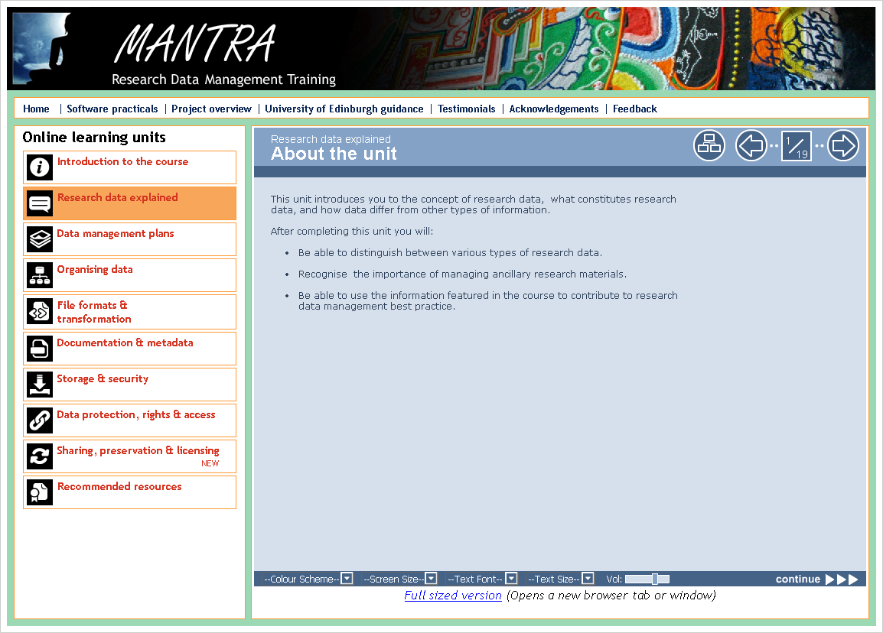
Research Data MANTRA
Free online interactive training modules
Aimed at postgraduates and early career researchers
http://datalib.edina.ac.uk/mantra/

Slide 28
Session review

Slide 29
In summary
Excellent of tools available
Internal and external
Select appropriately through data lifecycle
Internal and external training and further support also available

Slide 30
Acknowledgemets
DaMaRO RDM Training Materials, University of Oxford
http://damaro.oucs.ox.ac.uk/training_materials.xml

